Slide 1

Information Assistant Chunking
Industry & Partner Sales
WW Public Sector
George Earl

Slide 2
Retrieval Augmented Generation (RAG)
User Question
LLM Workflow
Query My Data
Search Index
Add Results to Prompt
Query Model
Large Language Model
Send Results

Slide 3

Retrieval augmented generation: bring your data to the prompt
Prompt
You are an intelligent assistant helping Contoso Inc employees with their healthcare plan questions and employee handbook questions. Answer the following question using only the data provided in the sources below.
Question: Does my health plan cover annual eye exams?
Sources:
1. Northwind Health Plus offers coverage for vision exams, glasses, and contact lenses, as well as dental exams, cleanings, and fillings.
2. Northwind Standard only offers coverage for vision exams and glasses.
3. Both plans offer coverage for vision and dental services.
Response
Based on the provided information, it can be determined that both health plans offered by Northwind Health Plus and Northwind Standard provide coverage for vision exams. Therefore, your health plan should cover annual eye exams.
Text input that provides some framing as to how the engine should behave
User provided question that needs to be answered
Sources used to answer the question
Notes:
Combining your data with prompts is a powerful concept. In this example, a question-answering prompt is used with 3 distinct pieces. The prompt starts with framing, providing the Generative AI with the context it needs on how to behave. The user-provided question is clearly defined separate from the framing. Finally, clearly formatted sources are provided at the bottom of the prompt. The Generative AI synthesizes all this information together and produces a correct response.

Slide 4
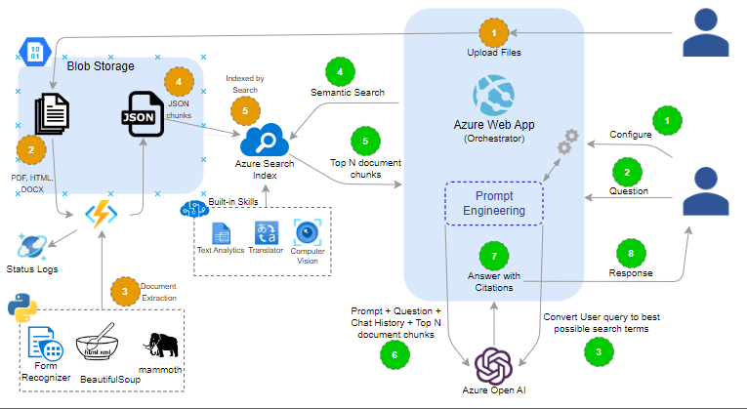
Information Assistant Architecture
Notes:
Azure AI Document Intelligence

Slide 5
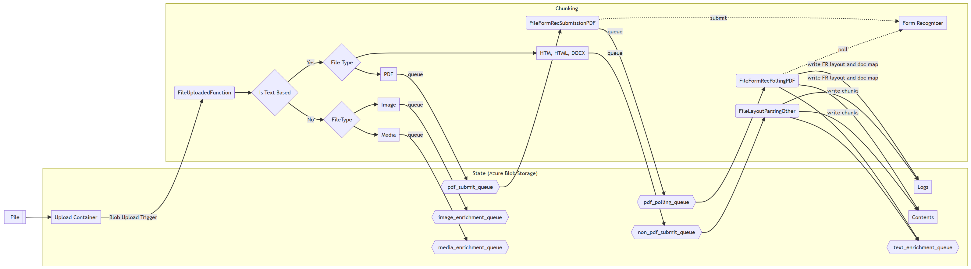
Chunking flow
Notes:
Mammoth (docx) to html
Beautiful soup, html to document map
Azure AI Document Intelligence

Slide 6

Chunking output
{
"file_name": "",
"file_uri": "",
"processed_datetime": "2023-08-10T21:27:57.258334",
"title": "",
"section": "",
"pages": [
1,
2,
3
],
"token_count": 9,
"content": ""
}
Notes:
We use heading tags and sections in pdf from FR
Azure AI Document Intelligence

Slide 7
Thank you

